Slide 1
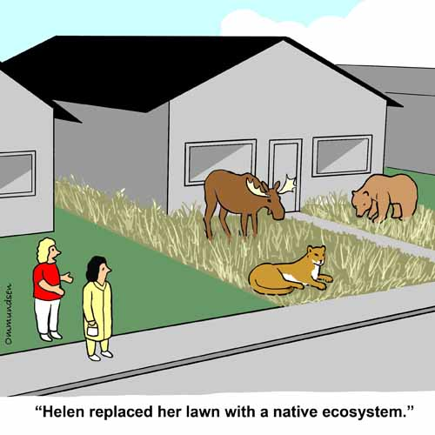
Chapter 46
Terrestrial and Aquatic Ecosystems

Slide 2
46.2 Terrestrial Ecosystems
Biome
  Major terrestrial ecosystem characterized by climate and geography
  A particular mix of plants and animals adapted to living under certain environmental conditions
  Tend to repeat wherever temperature and precipitation are the same
  Supports characteristic types of animals, although many migrate from one biome to another

Slide 3
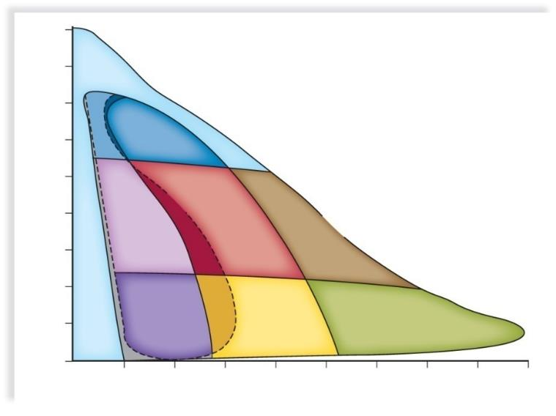
Biome Pattern of Temperature and Precipitation
Copyright © The McGraw-Hill Companies, Inc. Permission required for reproduction or display.
−15
Arctic-
alpine
− 10
tundra
− 5
cold
temperate
0
taiga
5
temperate
deciduous
forest
Mean Annual Temperature (°C)
shrubland
woodland
10
temperate
rain forest
15
warm
temperate
semidesert
grassland
20
thorn scrub
savanna
tropical
seasonal
forest
tropical
25
desert
tropical
rain forest
30
50
100
150
200
250
300
350
400
450
Mean Annual Precipitation (cm)
a. Biome pattern of temperature and precipitation

Slide 4

Distribution of Biomes
Copyright © The McGraw-Hill Companies, Inc. Permission required for reproduction or display.
polar ice
tundra
taiga
mountain zone
temperate deciduous forest
temperate rain forest
tropical deciduous forest
tropical seasonal forest
tropical rain forest
shrubland
temperate grassland
savanna
semidesert
desert
b. Distribution of biomes
4

Slide 5
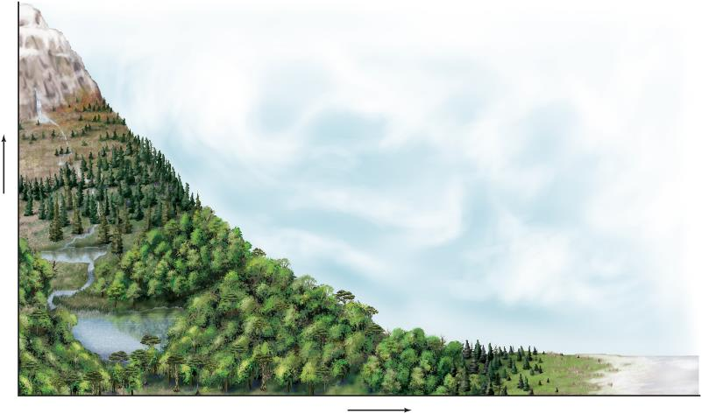
Climate and Biomes
Copyright © The McGraw-Hill Companies, Inc. Permission required for reproduction or display.
ice
alpine
tundra
montane
coniferous
forest
deciduous
forest
Increasing Altitude
tropical
forest
temperate
deciduous
forest
coniferous
forest
tundra
ice
Increasing Latitude

Slide 6
Terrestrial Ecosystems
Tundra
  Arctic Tundra - Encircles Earth just south of ice-covered polar seas in Northern Hemisphere
  Covers 20% of Earth’s land surface
  Permafrost layer never thaws
  Trees are not found in the tundra
    Growing season is too short
    Roots cannot penetrate permafrost
    Roots cannot become anchored in shallow boggy soil

Slide 7
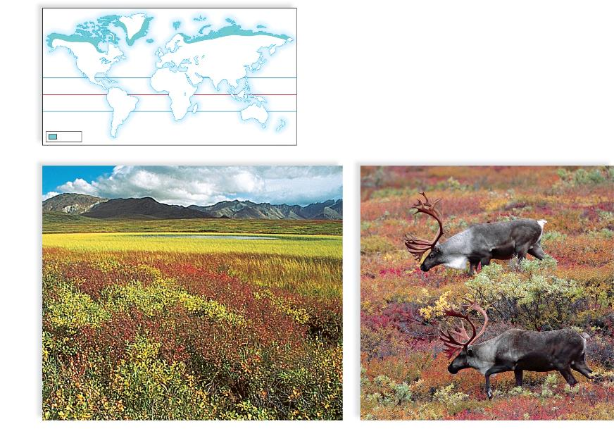
The Tundra
Copyright © The McGraw-Hill Companies, Inc. Permission required for reproduction or display.
tundra
a. Tundra vegetation
b. Tundra wildlife
a: © John Shaw/Tom Stack & Assoc.; b: © Danita Delimont/Getty Images

Slide 8
Terrestrial Ecosystems
Coniferous Forests
  Found in the taiga, near mountaintops, and along the Pacific Coast of North America
  Taiga typifies coniferous forest with cone-bearing trees
    Trees well adapted to cold
    Leaves and bark have thick covering
    Needle-like leaves can withstand weight of heavy snowfall
  Temperate Rainforest (old-growth forest) of Pacific Northwest
    Evergreen forest

Slide 9
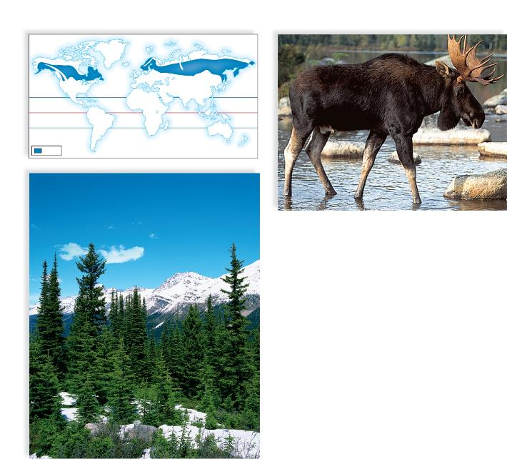
The Taiga
Copyright © The McGraw-Hill Companies, Inc. Permission required for reproduction or display.
taiga
b. Bull moose, Alces americanus, a large mammal
a. Spruce trees in the taiga biome
a: © Creatas/Jupiterimages RF; b: © Bill Silliker, Jr./Animals Animals

Slide 10
Terrestrial Ecosystems
Temperate Deciduous Forests
  Found south of taiga in eastern North America, eastern Asia, and much of Europe
  Moderate climate
    Relatively high rainfall
    Four well-defined seasons with long growing seasons
  Tallest trees form a canopy
  Ground-life is plentiful

Slide 11
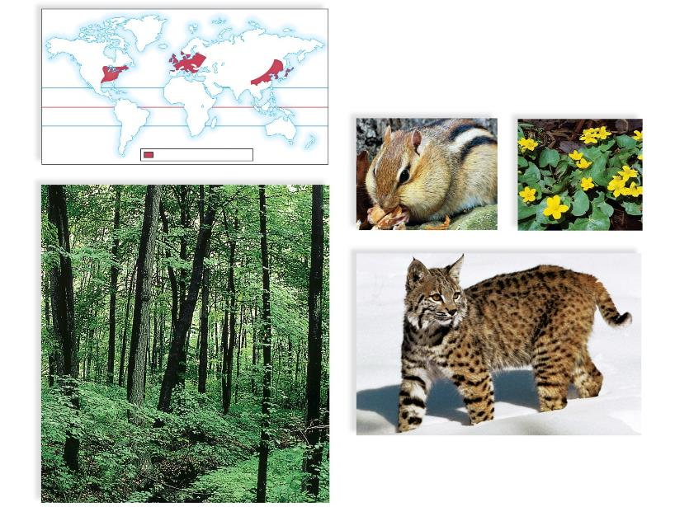
Temperate Deciduous Forest
Copyright © The McGraw-Hill Companies, Inc. Permission required for reproduction or display.
temperate deciduous forest
Eastern chipmunk, Tamias striatus
Marsh marigolds, Caltha howellii
Bobcat, Felis rufus
b. Animal life of forest biome
a. Temperate deciduous vegetation
a: © E. R. Degginger/Animals Animals; b (chipmunk): © Carmela Lesczynski/Animals Animals; b (bobcat): © Tom McHugh/Photo Researchers, Inc.;
b (marigolds): © Virginia Neefus/Animals Animals

Slide 12
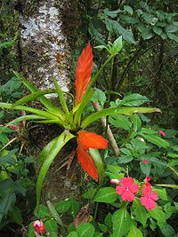
Terrestrial Ecosystems
Tropical Forests
  Tropical rainforests are found in equatorial regions
    Warm weather and plentiful rainfall
    Complex structure with forest floor, understory, and canopy
    Most animals live in trees
      Abundant insect life
    Epiphytes grow in many areas
    Soils are nutrient-poor
      Rapid recycling of nutrients

Slide 13
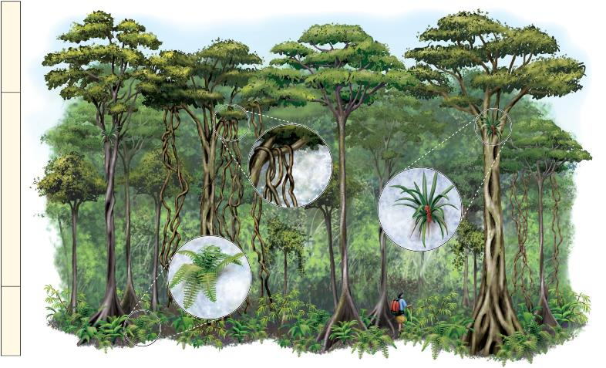
Levels of Life in a Tropical Rain Forest
Copyright © The McGraw-Hill Companies, Inc. Permission required for reproduction or display.
canopy
lianas
understory
epiphyte
fern
forest floor

Slide 14
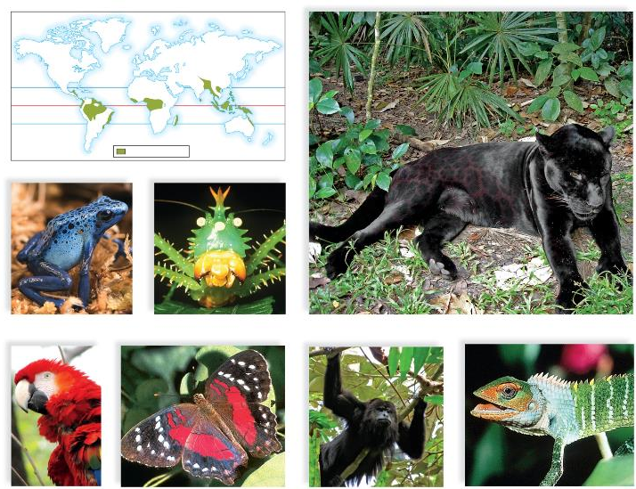
Representative Animals of the
Tropical Rain Forests of the World
Copyright © The McGraw-Hill Companies, Inc. Permission required for reproduction or display.
tropical rain forest
Poison arrow frog,
Dendrobates azureus
Cone-headed katydid,
Panacanthus cuspidatus
Panther,
Panthera onca
Scarlet macaw,
Ara macao
Brush-footed butterfly,
Anartia amalthea linnaeus
Black howler monkey,
Alouatta pigra
Arboreal lizard,
Calotes calotes
(katydid): © M. Fogden/OSF/Animals Animals; (jaguar, macaw, monkey): © Professor David F. Cox, Lincoln Land Community College; (butterfly, lizard): © Kjell Sandved/Butterfl y Alphabet

Slide 15
Terrestrial Ecosystems
Shrublands
  Tend to occur along coasts that have dry summers and wet winters
    Shrubs are adapted to withstand arid conditions
    Dense shrubland in California is known as chaparral
      Lacks an understory and ground litter
      Highly flammable

Slide 16
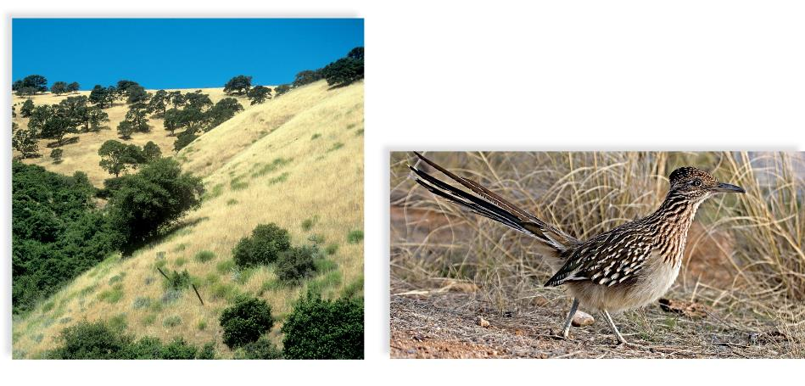
Shrubland
Copyright © The McGraw-Hill Companies, Inc. Permission required for reproduction or display.
a. Shrubland overview
b. Wildlife of the chaparral
a (chaparall): © Walt Anderson/Visuals Unlimited; b (roadrunner): © John Cancalosi/Peter Arnold/Photolibrary

Slide 17
Terrestrial Ecosystems
Grasslands
  Occur where annual rainfall is greater than 25 cm, but generally insufficient to support trees
  Grasses are well adapted to changing environment
  Temperate grasslands have cold winters and hot, dry summers
  Savannas have a cool dry season and a hot rainy season

Slide 18
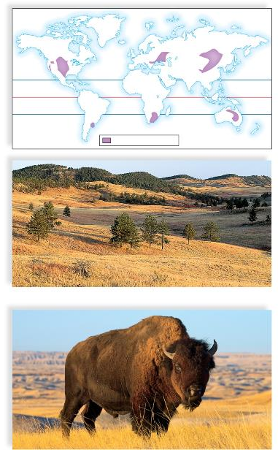
Temperate Grassland
Copyright © The McGraw-Hill Companies, Inc. Permission required for reproduction or display.
temperate grassland
a. Vegetation of the temperate grasslands
b. Wildlife of the temperate grasslands
(bison): © Eastcott Momatiuk/Getty RF; (prairie): © Jim Steinberg/Photo Researchers, Inc.

Slide 19
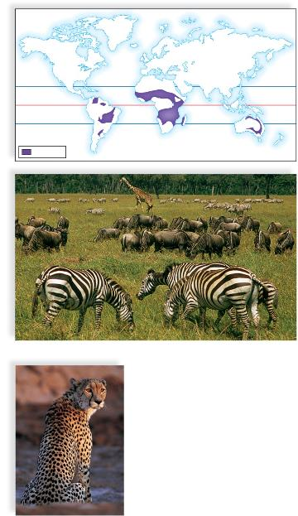
The Savanna
Copyright © The McGraw-Hill Companies, Inc. Permission required for reproduction or display.
savanna
a. Herbivores of the savanna biome
b. A carnivore of the savanna biome
(zebras and others): © Darla G. Cox; (cheetah): © Digital Vision/Getty RF

Slide 20
Terrestrial Ecosystems
Deserts
  Usually found at latitudes of about 30° in both hemispheres
    Cover nearly 30% of the Earth’s land surface
    Descending winds lack moisture
    Annual rainfall is less than 25 cm
    Large temperature differential between day and night

Slide 21
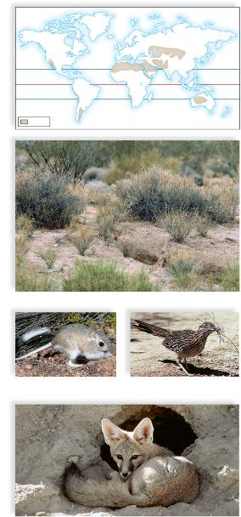
The Desert
Copyright © The McGraw-Hill Companies, Inc. Permission required for reproduction or display.
desert
a. Desert vegetation
Bannertail kangaroo rat,
Dipodomys spectabilis
Greater roadrunner,
Geococcyx californianus
Kit fox, Vulpes velox
b. Animal life of desert biome
a: © Jonathan Blair/Corbis; b(rat): © Bob Calhoun/Bruce Col man/Photoshot; b(roadrunner): © Jack Wilburn/Animals Animals; b(kit fox): © Jeri Gleiter/Peter Arnold/Photolibrary

Slide 22
46.3 Aquatic Ecosystems
Aquatic ecosystems are classified as
  Freshwater (inland) or
  Saltwater
  Brackish water is a combination of both
Wetlands are areas that are wet for at least part of the year
  Marshes – frequently or continually inundated by water
  Swamps – dominated by woody plants or shrubs
  Bogs – characterized by acidic waters, peat deposits, and sphagnum moss
22

Slide 23
Aquatic Ecosystems
Lakes
  Bodies of water classified by nutrient status
    Oligotrophic - Nutrient-poor
    Eutrophic - Nutrient-rich
    Oligotrophic lakes can become eutrophic lakes through the process of eutrophication

Slide 24
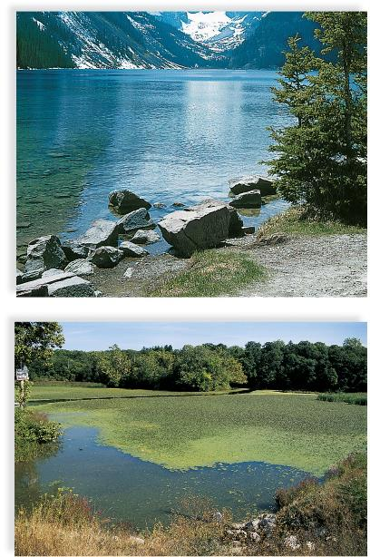
Types of Lakes
Copyright © The McGraw-Hill Companies, Inc. Permission required for reproduction or display.
a. Oligotrophic lake
b. Eutrophic lake
a: © Roger Evans/Photo Researchers, Inc.; b: © The McGraw-Hill Companies, Inc. Pat Watson, photographer

Slide 25
Aquatic Ecosystems
Lakes (continued)
  In temperate zones, deep lakes are stratified in the summer and winter and have distinct vertical zones
    In summer, lakes have three layers that differ in temperature:
      Epilimnion – surface layer (warm water)
      Thermocline – middle layer (cooler than epilimnion)
      Hypolimnion – bottom layer (cold)

Slide 26
Aquatic Ecosystems
Lakes (continued)
  Fall overturn
    Epilimnion water becomes cooler than the water in the hypolimnion
      Causes the surface water to sink and deep water to rise
      Process continues until temperature is uniform throughout the lake
  Spring overturn
    As ice melts, cooler water on top sinks below warmer water on the bottom

Slide 27
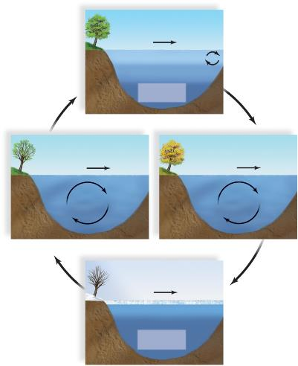
Lake Stratification in a Temperate Region
Copyright © The McGraw-Hill Companies, Inc. Permission required for reproduction or display.
wind
epilimnion 24°–25°C
thermocline 13°–18 °
hypolimnion
5°–8°
Summer Stratification
wind
wind
Spring Overturn
Fall Overturn
wind
ice
2°–3°C
most of lake
4°C
Winter Stratification

Slide 28
Aquatic Ecosystems
Life Zones
  Plankton
    Important community in fresh water and salt water ecosystems
      Phytoplankton - Photosynthetic algae
      Zooplankton – Tiny animals that feed on the phytoplankton
  Life Zones
    Littoral zone - Closest to shore
    Limnetic zone - Sunlit areas
    Profundal zone - Below light penetration
    Benthic zone - Soil-Water interface

Slide 29
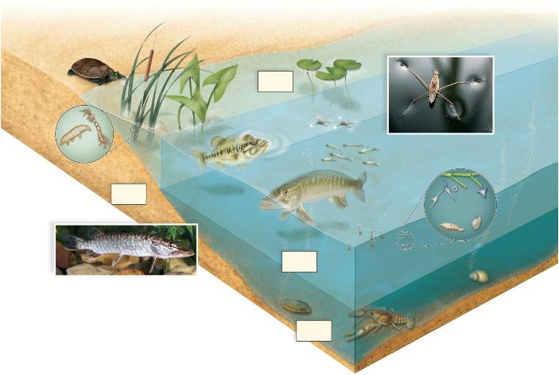
Zones of a Lake
Copyright © The McGraw-Hill Companies, Inc. Permission required for reproduction or display.
Littoral
Zone
surface organisms
clinging
organisms
Water strider , Gerris sp.
fishes
Benthic
Zone
phytoplankton
zooplankton
insect larvae
Limnetic
Zone
Northern pike, Esox lucius
bottom-dwelling
organisms
Profundal
Zone
(Pike): © Robert Maier/Animals Animals/Earth Scenes; (Water strider): © G.I. Bernard/Animals Animals/Earth Scenes

Slide 30
Aquatic Ecosystems
Coastal Ecosystems
  Estuary
    Partially enclosed bodies of water where fresh water and seawater meet and mix
    Organisms must be able to adapt to changing salinity
    Nearly two thirds of all marine fishes and shellfish require development in estuaries

Slide 31
Aquatic Ecosystems
Coastal Ecosystems
  Rocky and sandy shores
    Constantly bombarded by the sea
    Intertidal zone
      Lies between high and low tide
      Many attached organisms

Slide 32
Aquatic Ecosystems
Oceans
  Euphotic Zone (shallow ocean waters)
    Contain a greater concentration of organisms than the rest of the sea
  Coral reefs
    Located just below the surface in shallow, warm, tropical waters
    Densely populated with life
32

Slide 33
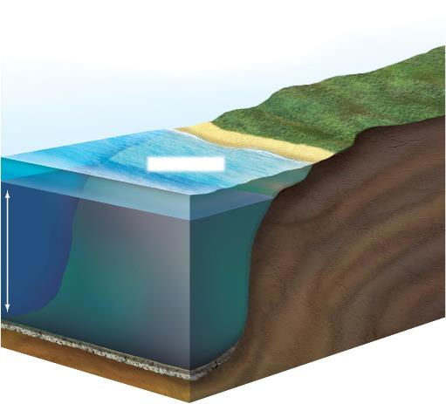
Ocean Ecosystems
Copyright © The McGraw-Hill Companies, Inc. Permission required for reproduction or display.
low tide
high tide
intertidal zone
euphotic zone
continental
shelf
deep-sea
waters
continental
slope
abyssal plain

Slide 34
Biomagnification of Mercury
Mercury becomes a serious environmental risk when it undergoes bioaccumulation in an organism’s body
Mercury enters ecosystems at the base of the food chain and increases in concentration as it moves up
  Top-level predators and organisms that are long-lived are the most susceptible to high levels of mercury accumulation
Mercury exposure for humans primarily occurs by eating contaminated fish
  Can lead to sterility in males, damage to the central nervous system, and birth defect in humans
Mercury travels through food webs to terrestrial ecosystems
  High levels of mercury have been found in terrestrial birds

