Slide 1


Routines
- and -
Procedures
Notes:
To add slides: Right click on a similar slide and select “copy.” Then “paste” the slide where you want it.
To delete slides: Right click on the slide you do not want and choose “delete slide.”

Slide 2



Welcome to 2nd Grade!
Notes:
To add slides: Right click on a similar slide and select “copy.” Then “paste” the slide where you want it.
To delete slides: Right click on the slide you do not want and choose “delete slide.”

Slide 3
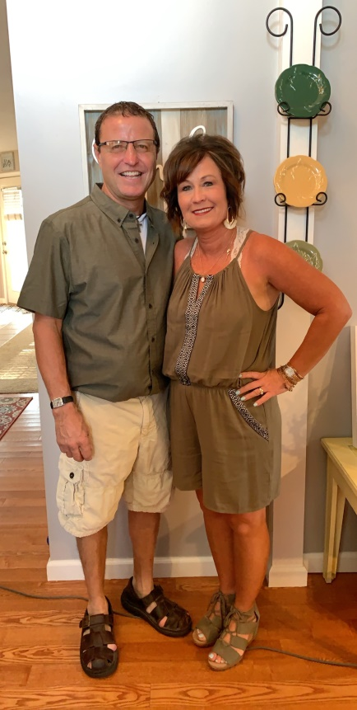
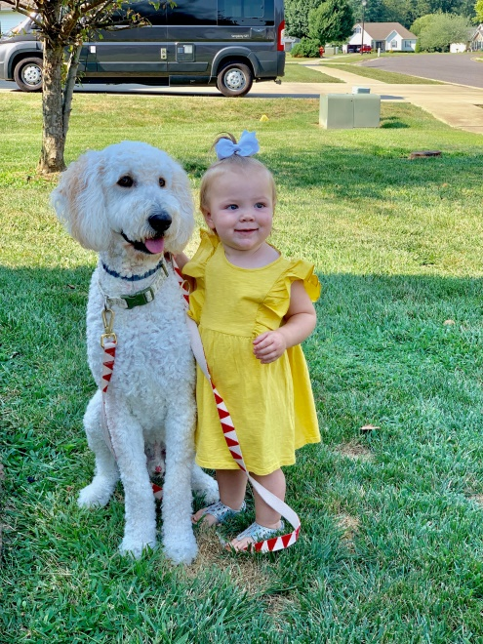
All About Me!
I have been married to Mr. Naugle for 21 years. He is a plumber. I have been a teacher for 25 years and have taught fourth grade and second grade. I love being a teacher and am excited to get too know all of you this year! I hope you learn a lot and have fun this year. In my free time, I like to read books, go shopping and watch my grand-daughter Everlee.
Notes:
Right click on the picture above, and choose “Change Picture.” Find your favorite picture and insert it on this slide! You can add additional pictures to this slide if you’d like. If you want to make the pictures larger, just drag the corner of the picture.

Slide 4

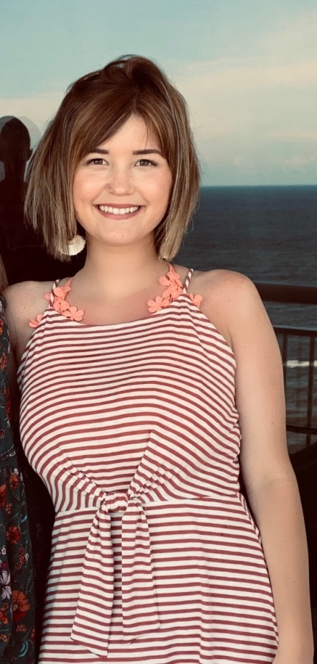
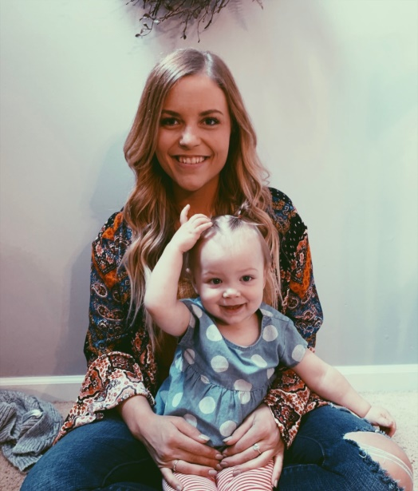
My Kids!
I have 4 children. Haley is the oldest and she is Everlee’s mom. She is a cosmotologist and works at Pixie Salon In Carlinville. Hannah is going to school to be an esthetician. Aidan is a senior and Camden is in 8th grade. Both boys love sports!
Notes:
Right click on the picture above, and choose “Change Picture.” Find your favorite picture and insert it on this slide! You can add additional pictures to this slide if you’d like. If you want to make the pictures larger, just drag the corner of the picture.

Slide 5


Classroom Rules
Be respectful
Be responsible
Be safe
Be kind

Slide 6
Routines
Procedures
- and -
Notes:
To add slides: Right click on a similar slide and select “copy.” Then “paste” the slide where you want it.
To delete slides: Right click on the slide you do not want and choose “delete slide.”

Slide 7
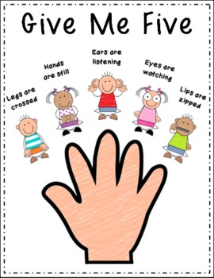

Quiet Signal
Teacher | Students
Says, “Class” | Respond, “Yes”
Says, “Give Me Five” | Put your hand in the air.
Will count down from 5 to 0 | Eyes on the teacher, lips are zipped, hands are crossed on your desk, ears are ready to listen.
Notes:
Create an attention grabber to use with your class to get their attention. This will be used often during the first few weeks of school. You can add new attention grabbers throughout the year, but begin the year with one or two EASY and FUN ways to get the attention of the entire class. Add your own or use one of the examples I’ve included.

Slide 8

Morning Procedures
Greet your teacher.
Mark your lunch count.
Unpack your backpack and put it on the back of your chair.
Open your Home/School Binder
Put your homework in the tray.
Write your new homework in your agenda and show Mrs. Naugle.
Start your morning work.
Read a book from
your book tub.
9. Get ready for a great day!
Notes:
Review how to take care of supplies so they last. (Ex: Top on glue stick, snap the marker caps all the way into place, etc.)
Discuss the differences between community supplies and personal supplies.
Responsibility: I always talk to students about how their parents spend a lot of money on Back to School supplies. I tell students that I also spent some of my own money to buy things for the students to use in the classroom. I want students to understand it is their responsibility to take good care of their supplies so they can be used throughout the school year. We also talk about not being wasteful and too hard on the supplies (pushing down too hard on dry erase markers).

Slide 9

Morning Procedures
Make sure you have 2 sharpened pencils.
Get your book tub set it on your desk.
Take out books you have read.
Either take AR test on the ones you have read or turn them in for new ones.
Please be sure you put the books back in the correct bin(by color).
Read or take AR tests until the morning timer goes off.
Notes:
Make sure students know where to put their personal belongings when they enter the classroom. How should backpacks be hung? Where do lunch boxes go? Do jackets/sweaters stay in backpacks or can they hang on chairs or tie around the waist? Are personal belongings (toys, jewelry, special items) allowed at school?

Slide 10


Pencil Sharpening
Have 2 sharpened pencils each morning.
If a pencil breaks put it in the “dull” jar and get a new pencil from the “sharp” jar. You can only sharpen pencils when the “Later Gater” sign is up.
Always keep a sharpened pencil in your holder that is on your desk.

Slide 11
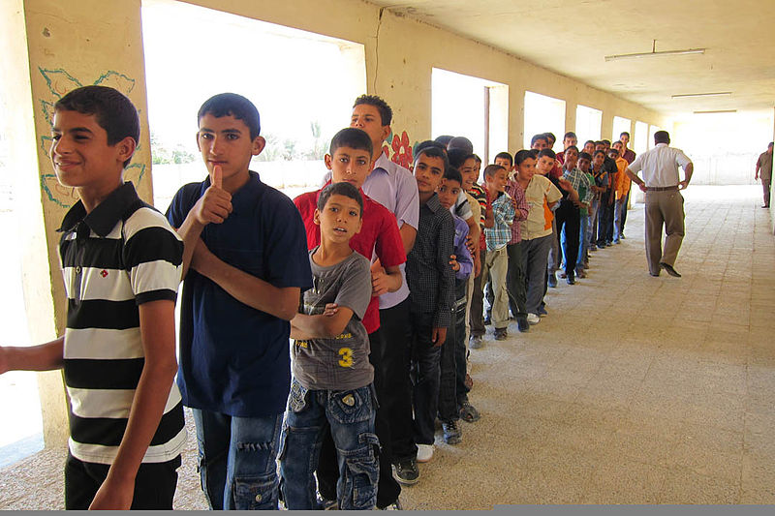
End of Day Procedure
1.When timer goes off, start cleaning up.
2. Put library books in bin and back on shelf.
3. Pick up floor around your desk.
4. Check binder and make sure homework is in homework folder.
5. Go get backpack and lunch box if you brought it.
6. Put binder in backpack and set on ground.
7. Sit quietly at your seat for end of day reflections.
8. When first bell rings, I will dismiss early bus riders.
Next, I will dismiss walkers and pickups.
Finally, I will dismiss late bus riders.
Notes:
Don’t assume students know what you mean! Show them EXACTLY how you expect them to turn in folders, papers, etc. For example, some children will turn in their assignment upside-down without even noticing. Have them double check that their name is on their paper before turning it in. Demonstrate how you want students to submit their work. =)

Slide 12
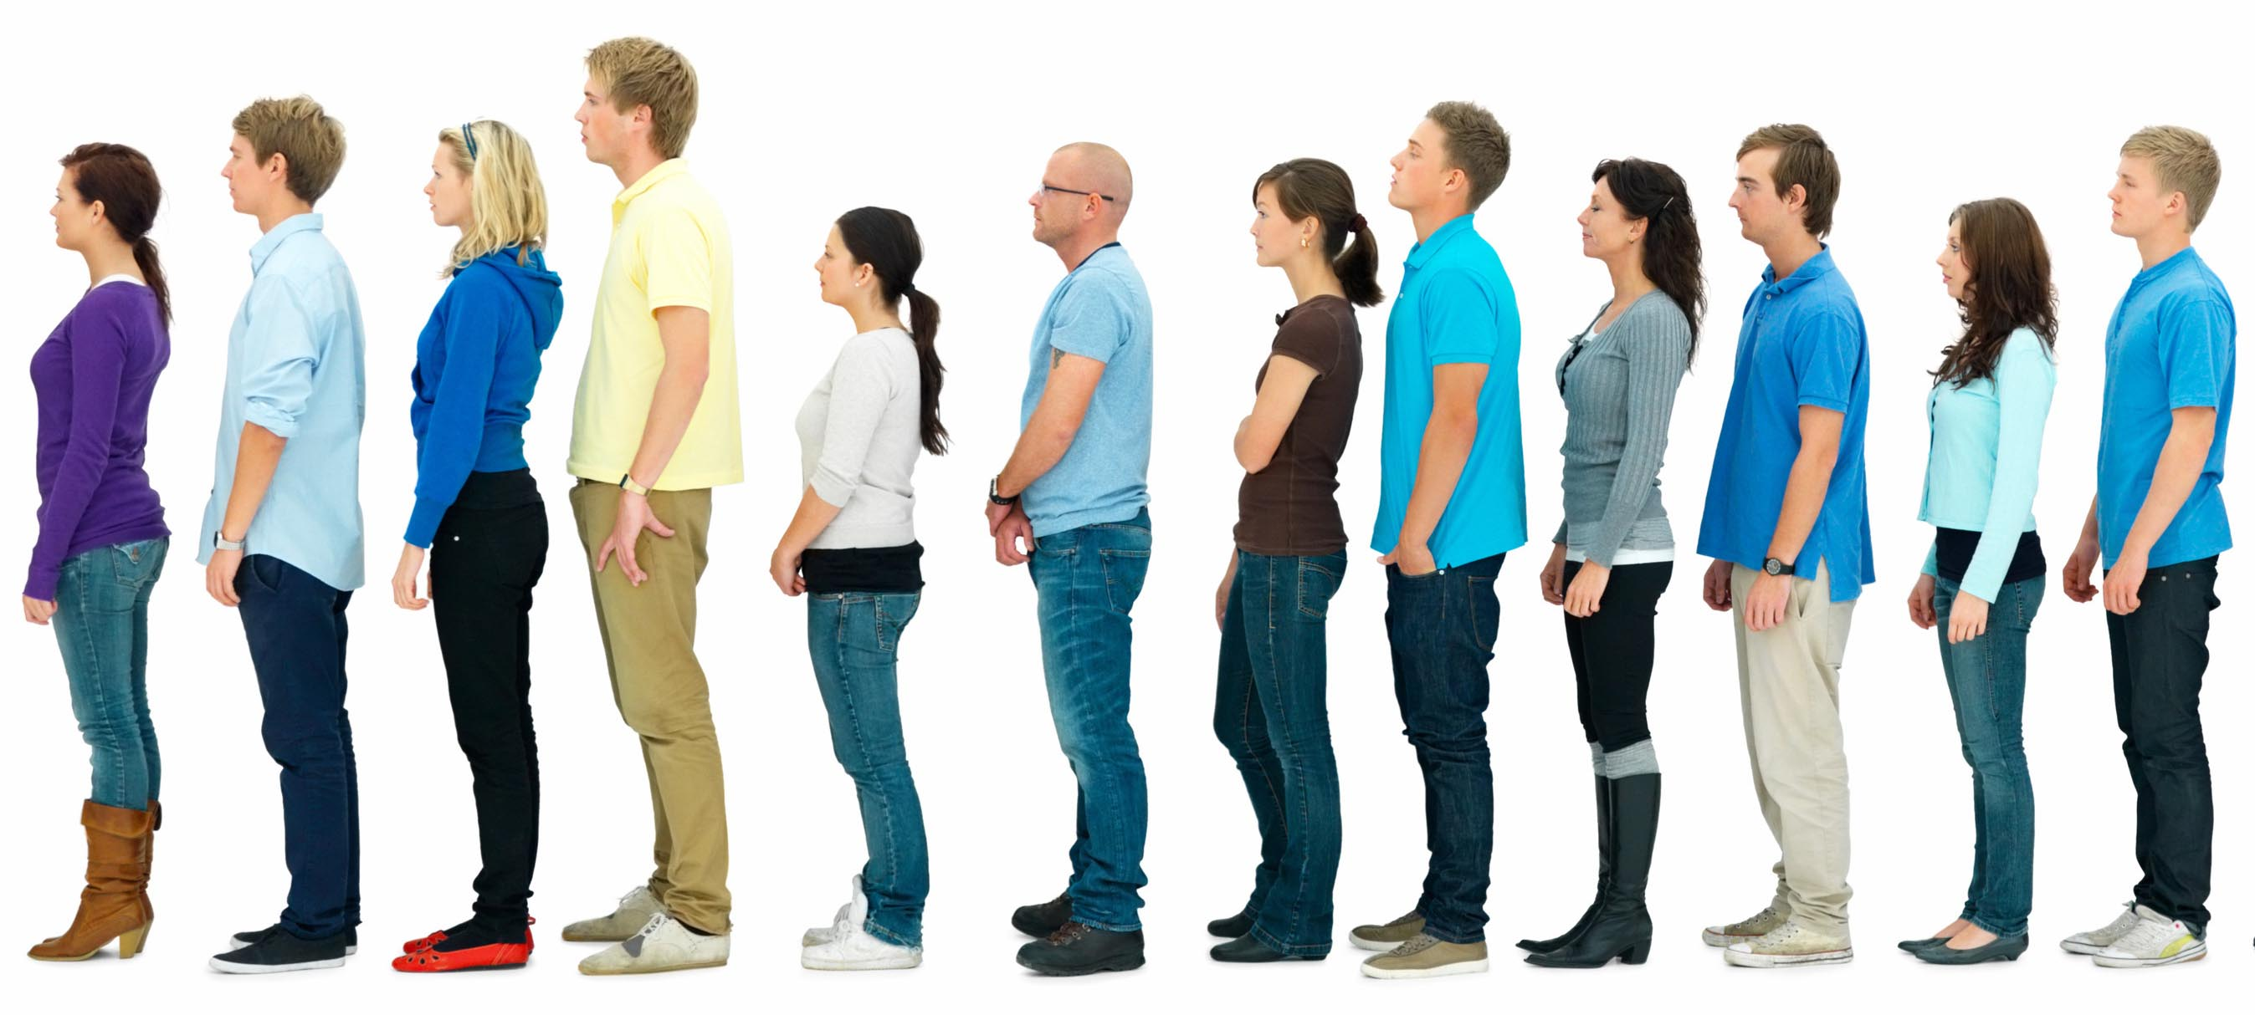
How to Line Up
Walk, don’t run to the door.
Line leader will lead us.
Hands behind back or at your side.
Level 0
Walk single line out the door and to our destination.
Notes:
If you don’t have a “Line Up” song or chant, simple Google it! There are hundreds of “line up” songs for FREE online. A friend taught me this line-up chant years ago, and it’s always very helpful in my classroom. Talk to students about where they stand when they line up, appropriate spacing between students, not touching the walls/materials, etc.

Slide 13

Hallway Behavior
Look at the Picture. Tell me what these students are doing wrong.
Notes:
Things to consider… Walking, hands to yourself, noise level, etc.
Remind students of the little things…”Don’t touch things that are hanging on the wall.”
Ask students: Should your behavior in the hallway be different when a teacher is not looking?

Slide 14
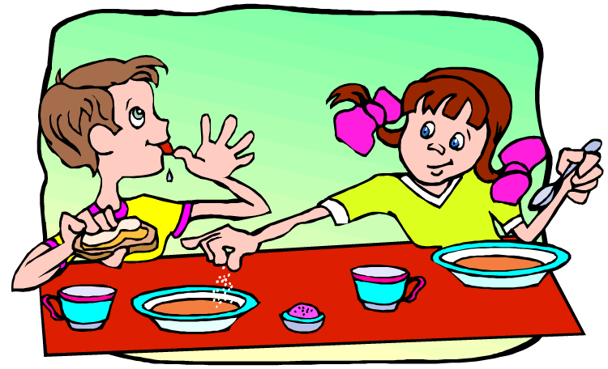
Cafeteria Behavior
Stand in single file line, waiting to get food, should be at level 1.
Go in, get a tray, or take your lunchbox to a seat.
No saving seats.
Be respectful, as you would with your parents at a restaurant.
No sharing food.
If you drop something on the floor, pick it up.
Raise your hand if you need something.
Notes:
While many student may know appropriate cafeteria behavior, new students will have had different cafeteria experiences. Thoroughly review rules, routines, and procedures for the cafeteria. Where do you get hot lunch? Where do you sit? What do you do when you are done with your lunch? Where are the trash cans? Make sure students know their lunch codes. If students bring their lunch but want to buy a drink, do they need to wait in line? Set your students up for success in the cafeteria by discussing all of these details and answering their questions about the lunchroom.

Slide 15

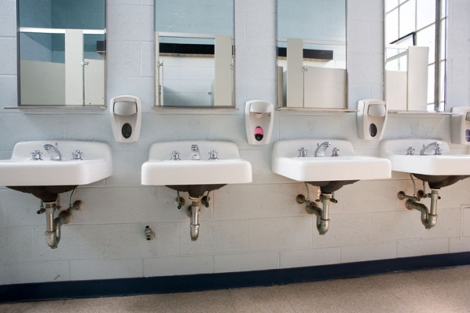
Restroom Behavior
Walk in line to the restroom.
If there is an open stall, use it, if not, wait patiently.
Level 1 voice
Wash hands. Use soap. Dry hands with paper towels, Get drink, if you need to.
Be respectful.
Quietly, get in line, hands behind back or at your side.
Level 0.
Notes:
Depending on the age of your students, you may need to go into detail about expectations for behavior in the restroom. Discuss what students should do while waiting in line and after they wash their hands. Think about where you want students to stand/sit while waiting. Some schools use the simple phrase, “Go, Flush, Wash, Leave!” to remind students how to behave in the restroom. For younger students, discuss bathroom signage so they do not get confused about which restroom to use! ☺ Don’t forget to discuss restroom times with students. Some teachers prefer to take classroom bathroom breaks, while others let students go individually. Remember, all teachers have different policies regarding restroom use. Make sure your policy is clear to students AND parents! TIP: Play “the quiet game” while students are waiting for their classmates.

Slide 16
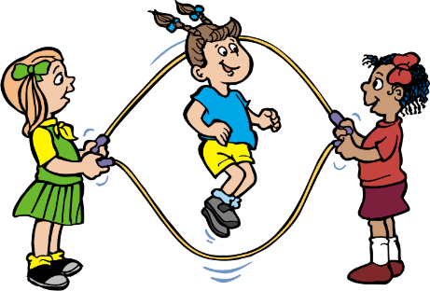

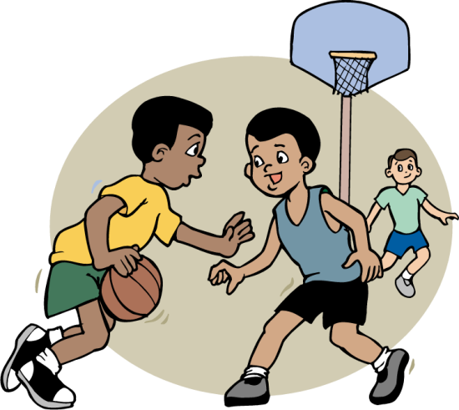
Recess
Before going outside, use the restroom if you need to.
Line up single file with hands behind your back or at your side, Level 0.
Wait quietly until teacher tells you to go.
Soccer-everyone can play. Play by the rules(play fair)
Slide- go up the slide and slide down. Do not stay at top of slide. Do not climb back up slide.
Be kind.

Slide 17
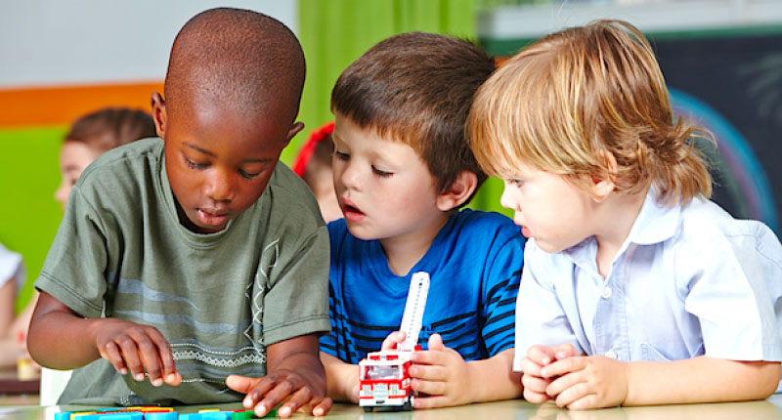
Center Procedures
Follow directions
Stay on task
Listen and help others
Ask 3 before me.
When finished, put completed paper in your group’s colored tray.
If you finish early, go back to your desk and read.
Notes:
See this short video on TpT for my tips and tricks for organizing & managing take home folders: https://www.teacherspayteachers.com/Product/Take-Home-Folders-How-to-set-up-organize-and-manage-Take-Home-Folders-3228095

Slide 18

Book check out procedure
Notes:
Use this time to talk with students about library books or your classroom library. Discuss expectations for borrowing books, checking out books, or for reading in the classroom library. If you have book bins, share with students your system for organizing books so they can put books back in the correct bin.

Slide 19
Rewards
Consequences
- and -
Notes:
To add slides: Right click on a similar slide and select “copy.” Then “paste” the slide where you want it.
To delete slides: Right click on the slide you do not want and choose “delete slide.”

Slide 20

Class DoJo
I am using a new behavior tool called DoJo. It is a web-site that allows me to give immediate feedback to my students on their behavior, positive and negative. Students will be awarded points for positive behavior and lose points for negative behaviors. There will be rewards for reaching certain point values. I will share those with you.
Notes:
Many teachers use a variety of reward systems, such as individual rewards, group incentives, and whole-class rewards. Choose the system that works best for you and use it consistently.

Slide 21
Dojo Store
$5 each | Pencil
$5 | Candy
$5 | Special Eraser
$5 | Superhero Tattoo
$5 | Superhero Bracelet
$10 | Bring a Stuffed Animal to School
$10 | Stress Ball
$10 | Show & Tell

Slide 22
Dojo Store
$10 | Pillow Pass for the Week
$20 | Wear a Hat to School
$30 | Stinky Feet Day
$30 | No Homework Pass
$30 | Water Bottle
$50 | IPAD Time

Slide 23
Dojo Store
$50 | Sit at the Teacher’s Desk for the Day
$60 | Lunch w/ Teacher & 2 Friends
$80 | Dairy Queen Treat

Slide 24


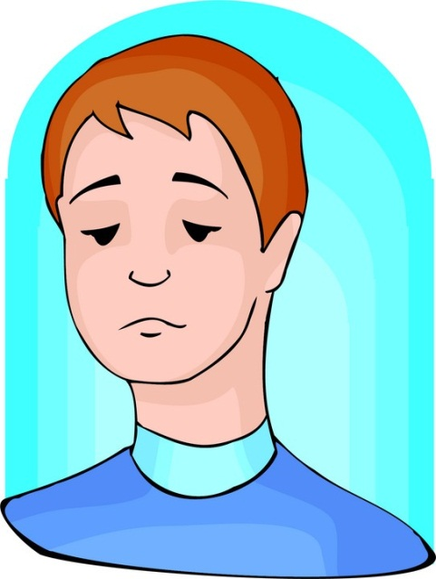
Consequences
You are responsible for your own behavior.
If you don’t make good choices, you may lose points on Class DoJo. If you do not follow procedures during center time, you may be asked to go back to your seat.
Notes:
Be firm and consistent beginning on Day 1. Make sure students and parents thoroughly understand your classroom management system. I would recommend sending information home with parents. Have them sign off that they have read and understand your classroom management system.

Slide 25



Teacher Info
Don’t try and teach all of this at once! Break it up into little sections. Review often the first few weeks of school. It’s also a great resource to use after Christmas Break or when Spring Fever hits. ☺
Check out the NOTES section at the bottom of every slide for classroom management pointers, tips, and tricks! Don’t assume students know what you mean; Demonstrate and discuss the nitty-gritty. You’ll be thankful you did later! ☺ It may not seem like you are getting a lot of academics taught during the first two weeks of school, but establishing your routines and procedures at the start of the year will set you up for success!
To add slides: Right click on a similar slide and choose “Duplicate Slide.”
To delete slides: Right click on the slide and choose “Delete slide.”
To rearrange slides: Drag and drop them in the order that works for you.
To change a picture: Right click on the picture, and choose “Change Picture.” Find your favorite picture and insert it! If you want to change the size of the picture, just click the corner of the picture and drag the picture in or out.
E-mail me at TheHappyTeacherTPT@gmail.com with any questions.
Notes:
To add slides: Right click on a similar slide and choose “Duplicate Slide.”
To delete slides: Right click on the slide you do not want and choose “delete slide.”

