Slide 1

Mrs. Naugle’s 2nd Grade!
Mrs. Naugle’s
2nd Grade!

Slide 2
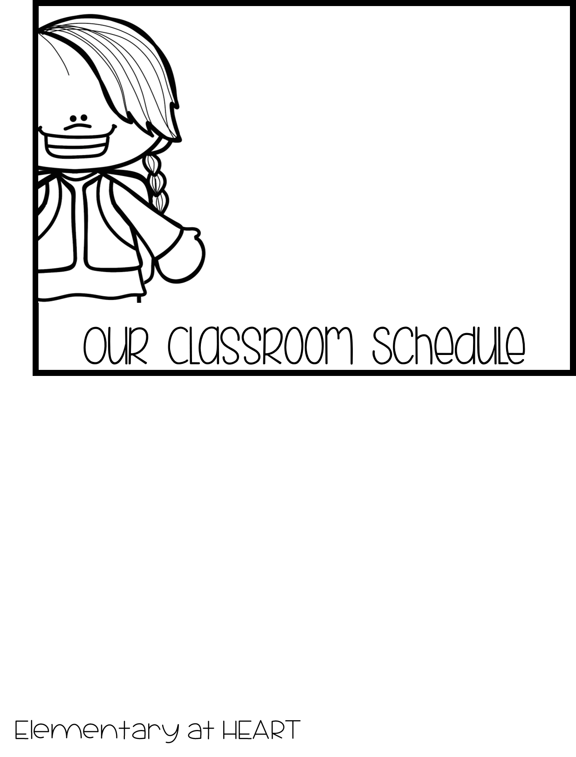
7:55 – School Begins 1:00 – Power Half-Hour
8:05 – Interventions 1:30-2:30 Centers/Writing
8:30 – Math 2:30-2:50 Read Aloud
9:50 – PE Dismissal Routine
10:20– Music (M, W)
Library (T)
Computer Lab (TH)
10:50 - Science
11:25 – 11:55 Lunch
11:55 – 12:20 Recess
12:25 – Reading/Language

Slide 3
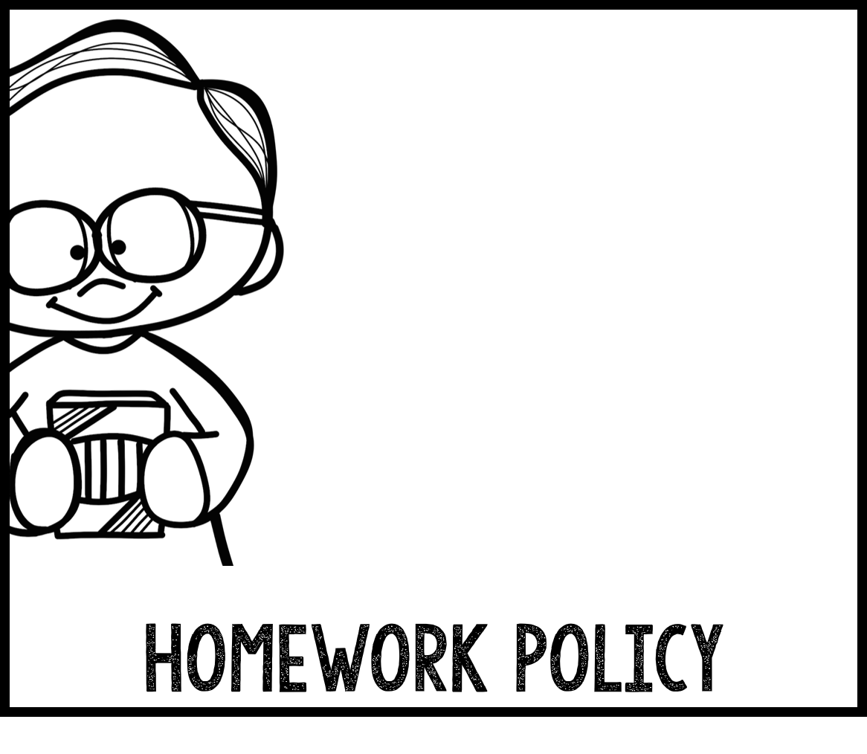
Your child will receive a weekly newsletter that will contain spelling, vocabulary and sight words for the week. It will also inform you of topics and skills we are learning that week in math and science.
Please check your child’s agenda daily. It is a district wide tool to help organize students, record behavior and communicate with parents. It will also be used to write homework assignments. I will check it daily for questions and comments from you. This is a great method of communication between teacher/parent.
Your child will be given homework to review skills and concepts we are learning in reading and math as needed. Please try to complete homework and return the next day.
Elementary at HEART

Slide 4
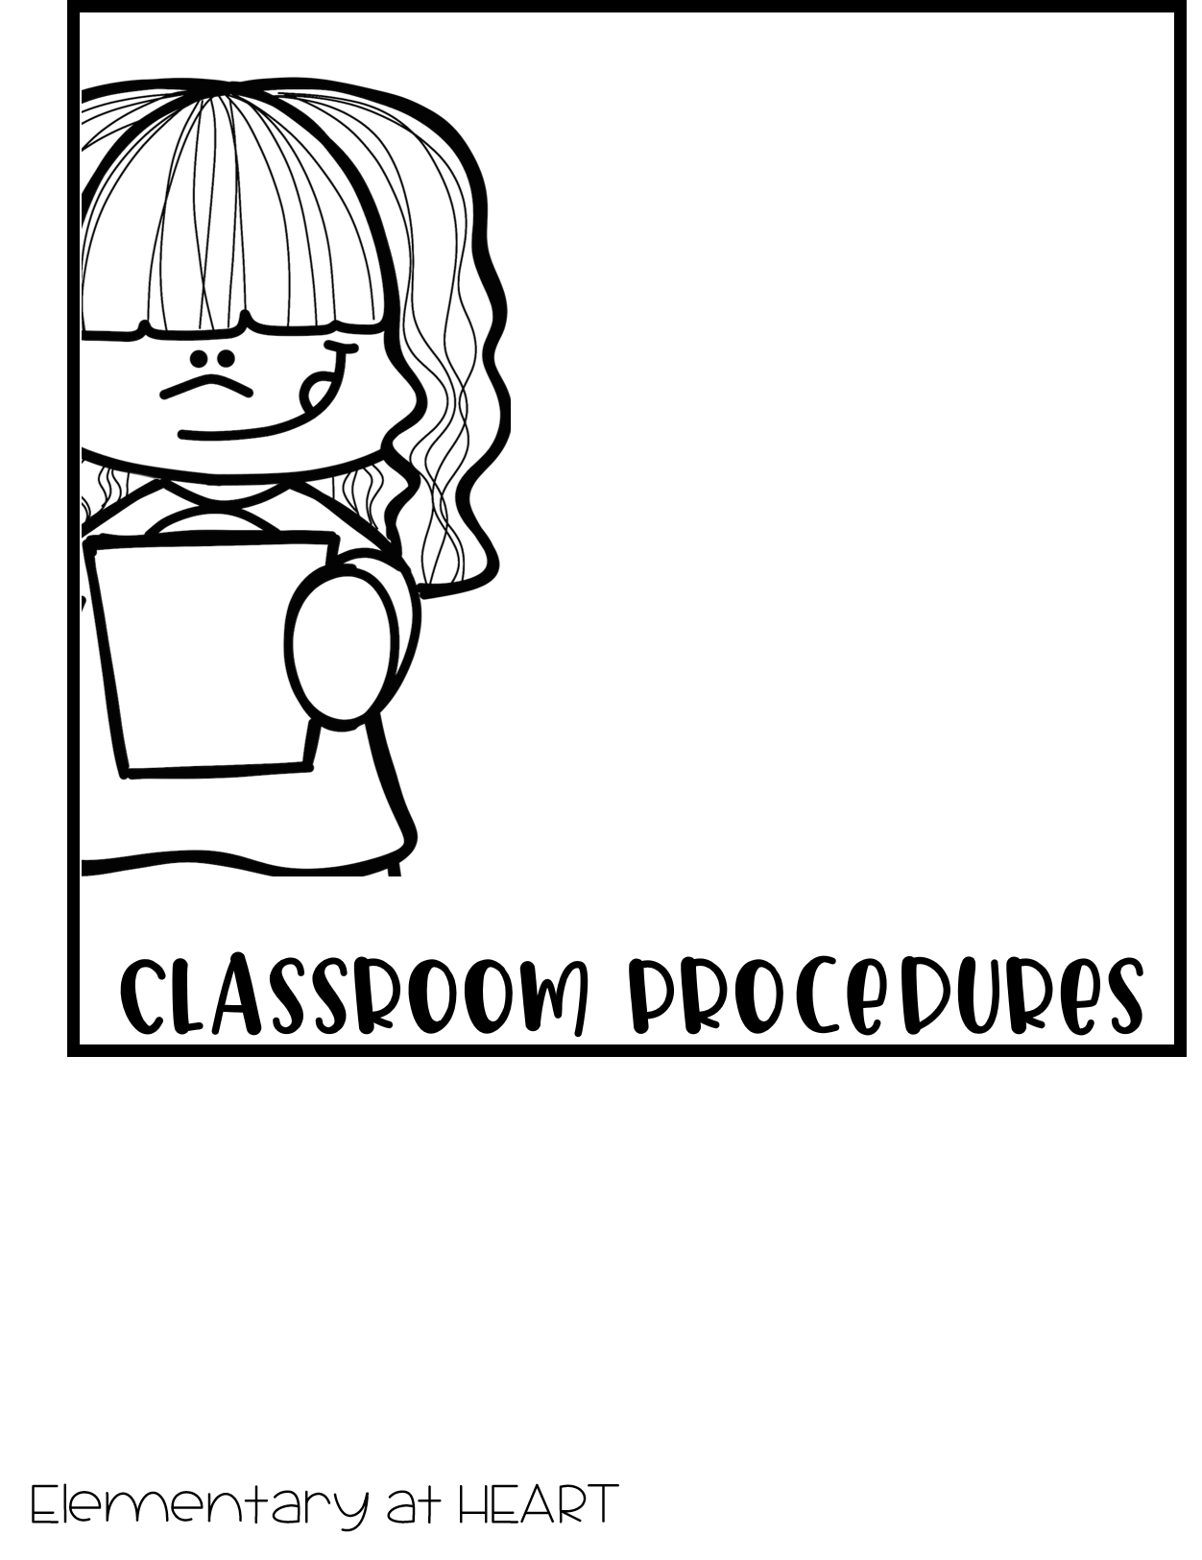
Home/School Binder:
Please check your child’s Home/School
Binder daily. Each day important papers,
notes and homework will be put in the
Homework Folder to be taken home. One
side is labeled LEFT at Home (please take
those papers out) and the other is labeled
Bring RIGHT Back (please return those
Items to school). Your child will become
responsible for unpacking and packing
his/her binder daily. This folder will be
kept in your child’s 3-ring binder along
with his/her agenda. Thank you!

Slide 5
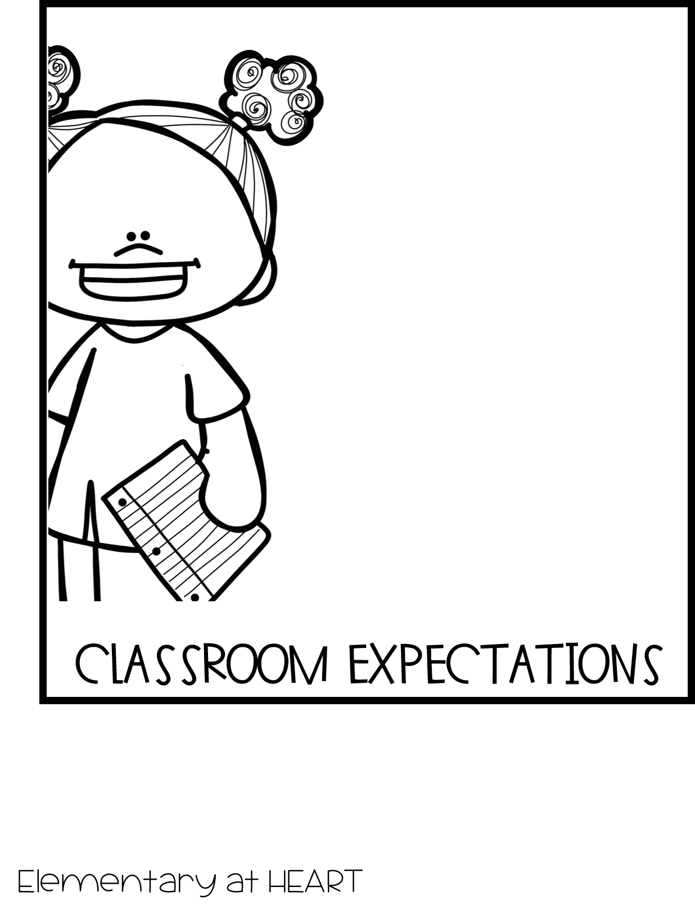
We work really hard to be safe,
respectful, responsible and kind
each day in second grade! This year I am trying ClassDojo to build our classroom community. I will post announcements, updates and reminders. Share photos and videos from our classroom activities. I will also send private messages to keep you in the loop of your child’s progress and behavior.
This is brand new for me and I am not very “techy” so bare with me. I am excited to be trying something new and have heard positive feedback about this program.

Slide 6

AR Reading Goals – Students will set an AR reading goal for
themselves each month. If your child meets or exceeds the
goal for the month, he/she will receive the monthly reward
and become an AR Achiever for that month! Students will have
an opportunity to read daily in our classroom, but will also take
home a Book Buddy Bag with an AR book to read at home a couple
days a week. All books read at home should be recorded on the
Reading Log which is in the Book Buddy Bag. Thank you for
developing life long readers!
Water Bottles/Snack – This is not required but students are allowed
to bring a filled water bottle to school each day. The water bottle
will go home each day for cleaning purposes but it is your
choice to fill it at home and return it the next day. We do not
buy class snacks in second grade. However, your child is allowed to
bring an individual snack from the approved snack list to
eat during our guided reading centers in the afternoon.
If you have any questions or concerns throughout the year, please feel free to contact me. I always have an open door policy. I look
forward to an amazing year with my new class!
EXTRA INFORMATION

